Slide 3

scribe

Slide 5
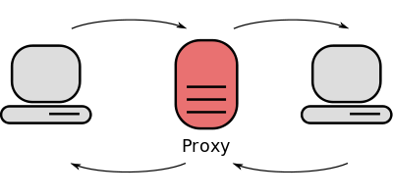
proxy

Slide 7

Business representative

Slide 9

sponsor

Slide 11

entrepreneur

